Slide 1
About Me
Education:
Ph.D. candidate in Computer Science, Shanghai Jiao Tong University.
Bachelor’s degree obtained from ACM class, Shanghai Jiao Tong University.
Research Interest:
Currently mainly focus on GANs. (2017 ~ now)
Also work on related problems, including optimization, optimal transport, etc.
Used to work on Computer Graphics. (2014 ~ 2016)
Surface reflectance acquisition, related to sparsity, low-rank, and deblurring.
Plan to extend and gradually move to Deep Learning Theory.

Slide 2
On the Convergence of GANs
Speaker: Zhiming Zhou
Notes:
此页可以删除

Slide 3
The Convergence Issues
Training instability
Unreachable optimum
Generalization issue
Symptoms:
Hyperparameter sensitive
Mode collapse
Training failure (diverge / crash)
Related work:
Lipschitz GANs. (ICML, 2019)

Slide 4
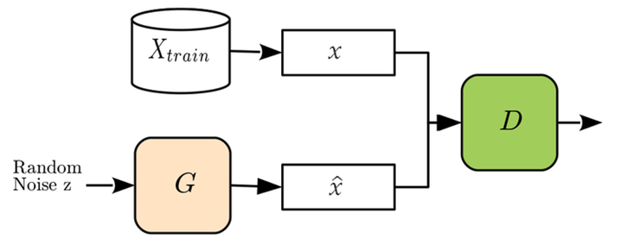
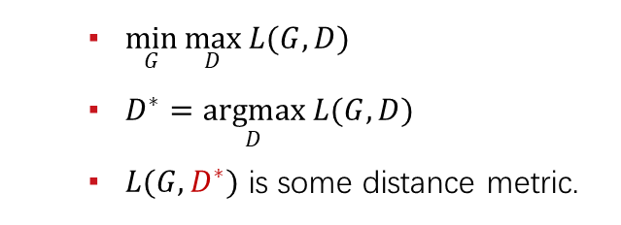
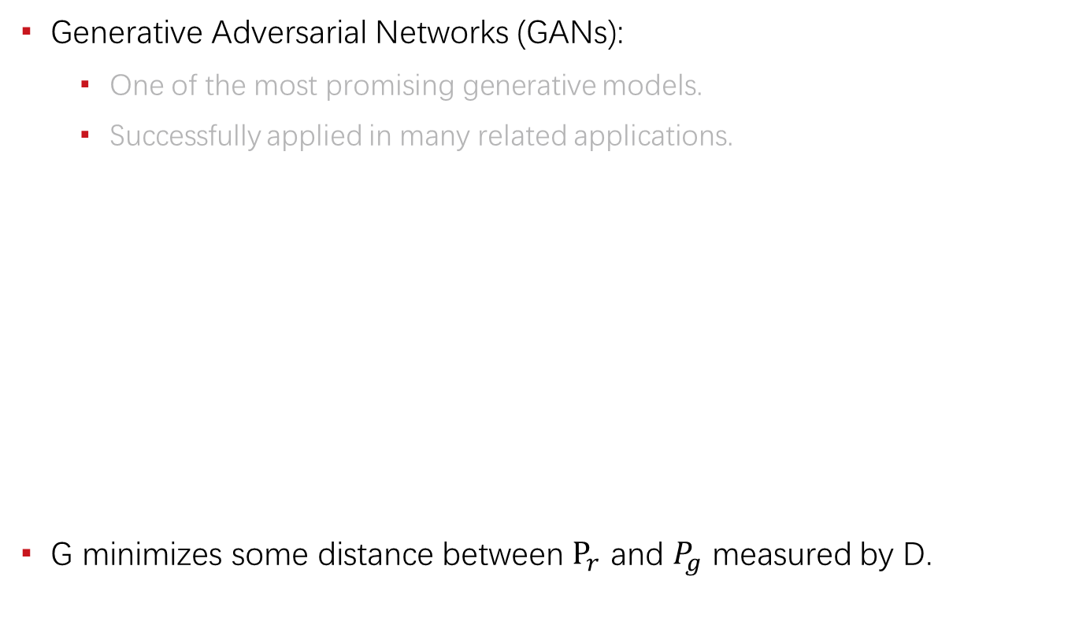
Introduction
Generative Adversarial Networks (GANs):
One of the most promising generative models.
Successfully applied in many related applications.
G minimizes some distance between $P_{r}$ and $P_{g}$ measured by D.
$\min_{G}{\max_{D}{L(G, D)}}$
$D^{∗}=\underset{D}{argmax}{L(G, D)}$
$L(G, D^{∗})$ is some distance metric.

Slide 5
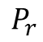
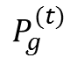
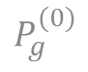
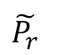
The Convergence Issues
Training instability
Unreachable optimum
Generalization issue
Symptoms:
Hyperparameter sensitive
Mode collapse
Training failure (diverge / crash)
Related work:
Lipschitz GANs. (ICML, 2019)
$$P_{g}^{(0)}$$
$$P_{g}^{(t)}$$
$$P_{r}$$
$$\tilde{P_{r}}$$
Training Instability
Unreachable optimum
Generalization Issue

Slide 6
Training Instability
Mainly from Lipschitz GANs. (ICML, 2019)

Slide 7
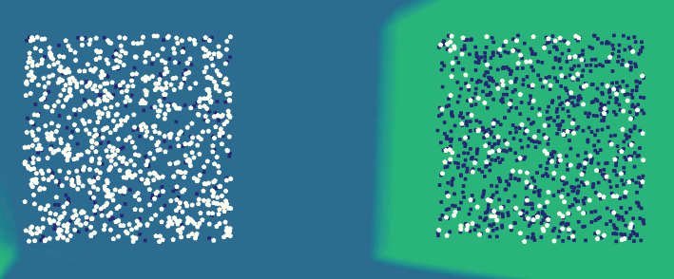
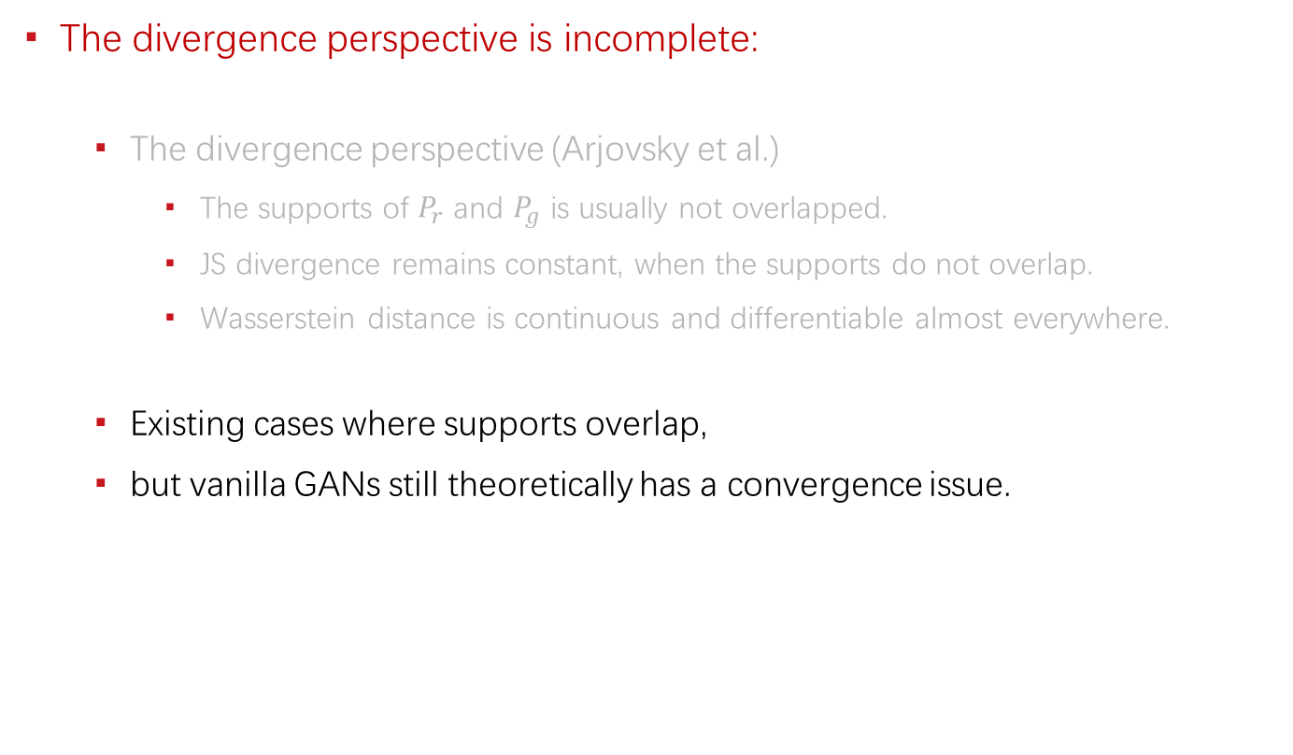
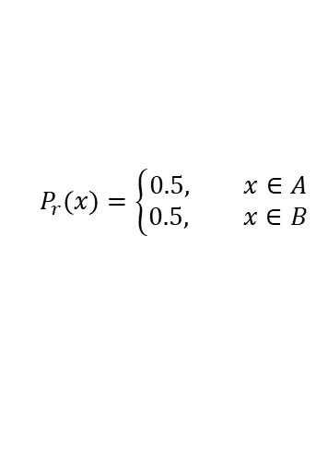
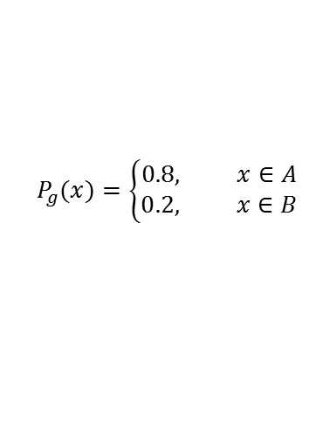
The Essence of Convergence
The divergence perspective is incomplete:
The divergence perspective (Arjovsky et al.)
The supports of $P_{r}$ and $P_{g}$ is usually not overlapped.
JS divergence remains constant, when the supports do not overlap.
Wasserstein distance is continuous and differentiable almost everywhere.
Existing cases where supports overlap,
but vanilla GANs still theoretically has a convergence issue.
$$P_{g}(x)=\left\{\begin{aligned}0.8, x∈A \\ 0.2, x∈B\end{aligned}\right.$$
$$P_{r}(x)=\left\{\begin{aligned}0.5, x∈A \\ 0.5, x∈B\end{aligned}\right.$$

Slide 8
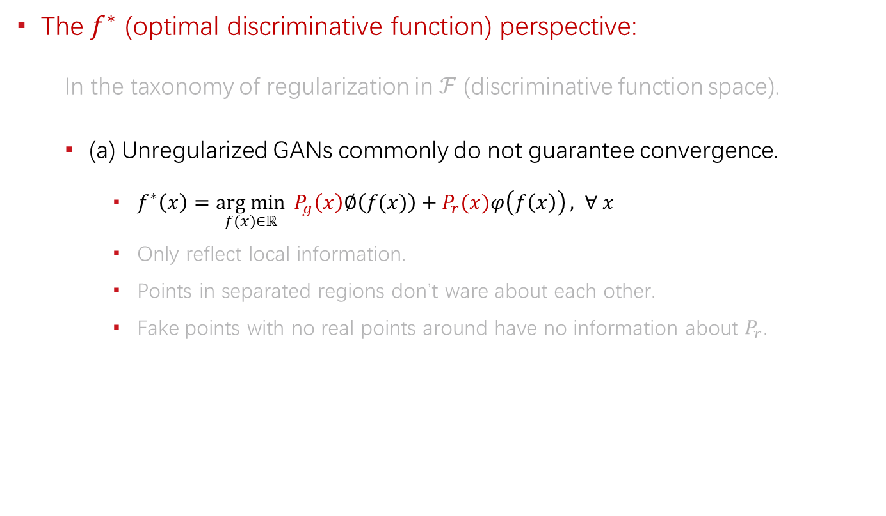
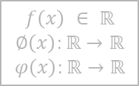
The Essence of Convergence
The $f^{∗}$ (optimal discriminative function) perspective:
In the taxonomy of regularization in $ℱ$ (discriminative function space).
(a) Unregularized GANs commonly do not guarantee convergence.
$f^{∗}\left(x\right)=\underset{f(x)∈ℝ}{arg min}{ P_{g}\left(x\right)∅\left(f(x)\right)+P_{r}(x)φ\left(f\left(x\right)\right)}, ∀ x$
Only reflect local information.
Points in separated regions don’t ware about each other.
Fake points with no real points around have no information about $P_{r}$.
$$f\left(x\right) ∈ ℝ$$
$$∅\left(x\right):ℝ→ℝ$$
$$φ\left(x\right):ℝ→ℝ$$
$$P_{g}(x)=\left\{\begin{aligned}0.8, x∈A \\ 0.2, x∈B\end{aligned}\right.$$
$$P_{r}(x)=\left\{\begin{aligned}0.5, x∈A \\ 0.5, x∈B\end{aligned}\right.$$
Including vanilla GAN, Least-squares GAN, f-GAN, etc.

Slide 9
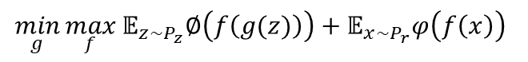
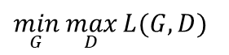
Generalized Formulation of GANs
$$\min_{G}{\max_{D}{L(G, D)}}$$
$$\min_{g}{\max_{f}}𝔼_{z\sim P_{z}}∅\left(f\left(g(z)\right)\right)+𝔼_{x\sim P_{r}}φ\left(f\left(x\right)\right)$$
$f$ is another notation for $D$ and $f^{∗}$ is the optimal $f$.

Slide 10
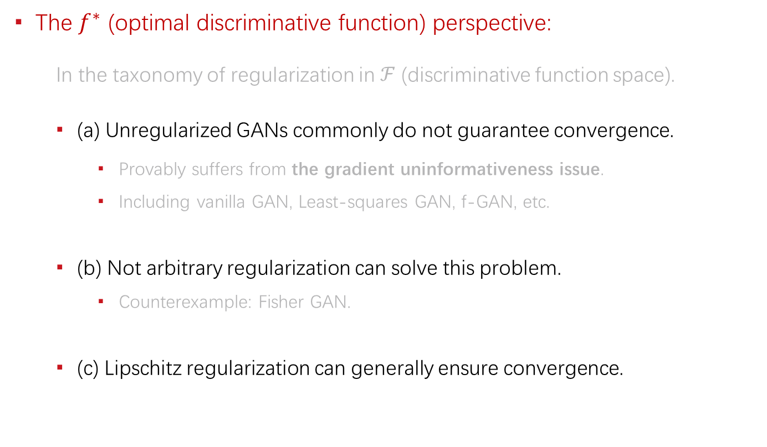
The Essence of Convergence
The $f^{∗}$ (optimal discriminative function) perspective:
In the taxonomy of regularization in $ℱ$ (discriminative function space).
(a) Unregularized GANs commonly do not guarantee convergence.
Provably suffers from the gradient uninformativeness issue.
Including vanilla GAN, Least-squares GAN, f-GAN, etc.
(b) Not arbitrary regularization can solve this problem.
Counterexample: Fisher GAN.
(c) Lipschitz regularization can generally ensure convergence.

Slide 11

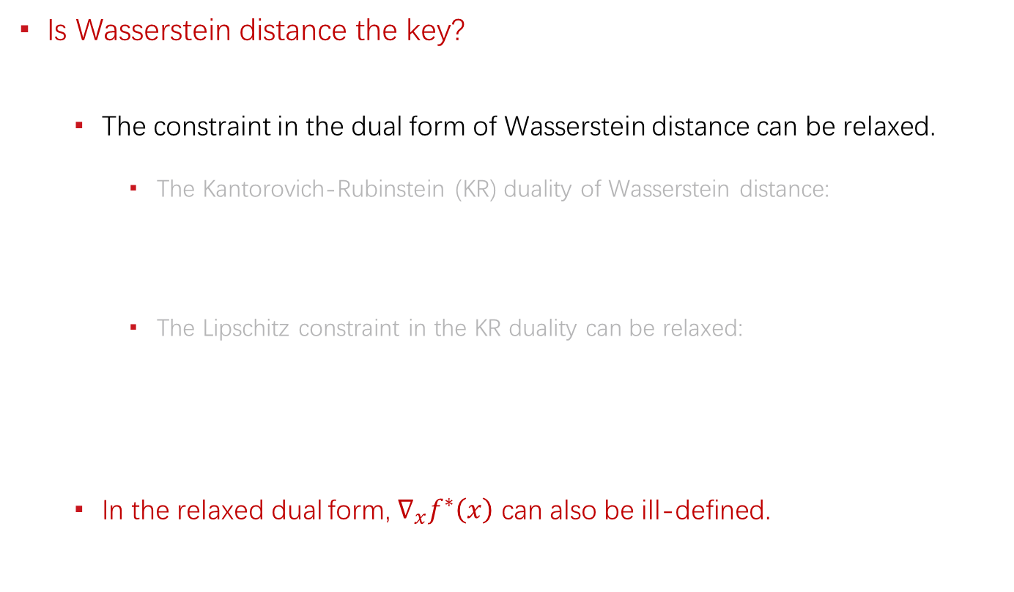

The Essence of Convergence
Is Wasserstein distance the key?
The constraint in the dual form of Wasserstein distance can be relaxed.
The Kantorovich-Rubinstein (KR) duality of Wasserstein distance:
The Lipschitz constraint in the KR duality can be relaxed:
In the relaxed dual form, $∇_{x}f^{∗}\left(x\right)$ can also be ill-defined.
$$W_{1}\left(P_{r}, P_{g}\right)=\sup_{f} 𝔼_{x\sim P_{r}}\left[f\left(x\right)\right]−𝔼_{x\sim P_{g}}\left[f\left(x\right)\right],$$
$$s.t. f\left(x\right)−f\left(y\right)≤d\left(x,y\right), ∀x, ∀y$$
$$W_{1}\left(P_{r}, P_{g}\right)=\sup_{f} 𝔼_{x\sim P_{r}}\left[f\left(x\right)\right]−𝔼_{x\sim P_{g}}\left[f\left(x\right)\right],$$
$$s.t. f\left(x\right)−f\left(y\right)≤d\left(x,y\right), ∀x∈supp(P_{r},) ∀y∈supp(P_{g})$$

Slide 12
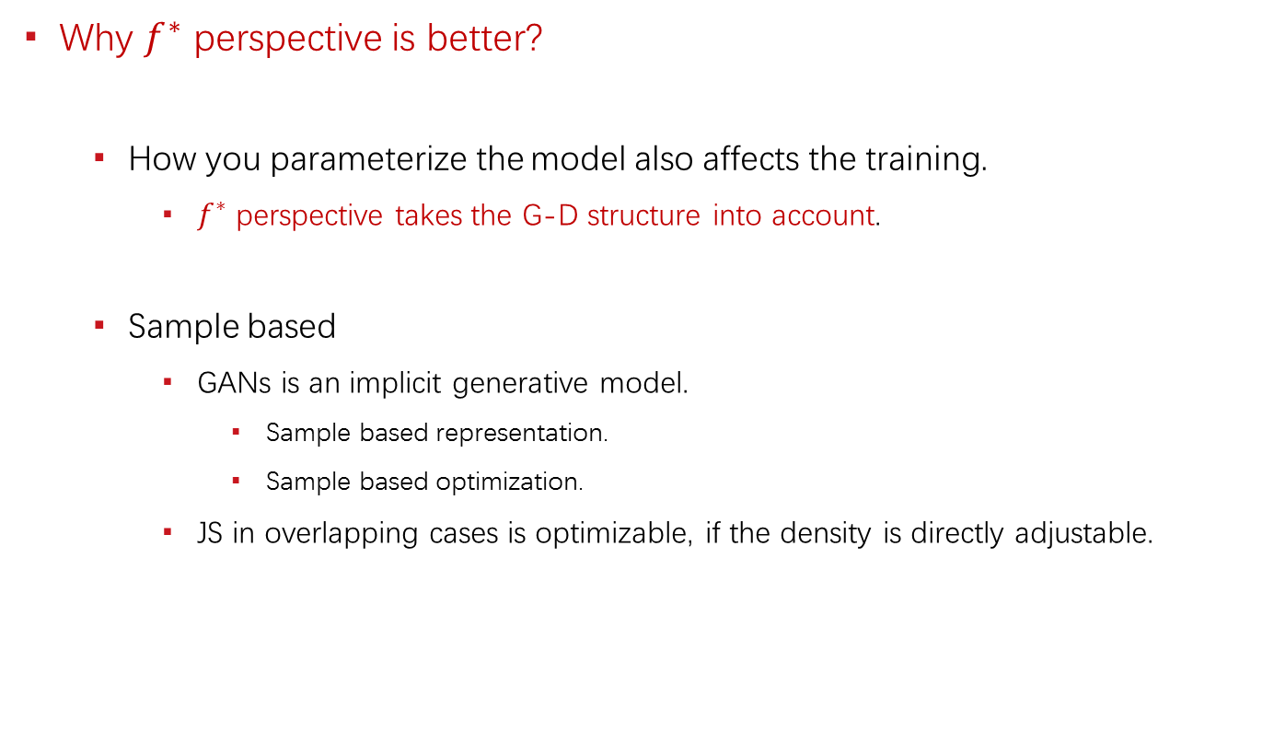
The Essence of Convergence
Why $f^{∗}$ perspective is better?
How you parameterize the model also affects the training.
$f^{∗}$ perspective takes the G-D structure into account.
Sample based
GANs is an implicit generative model.
Sample based representation.
Sample based optimization.
JS in overlapping cases is optimizable, if the density is directly adjustable.

Slide 13
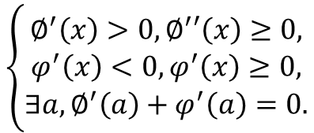
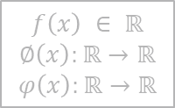
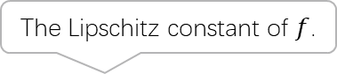
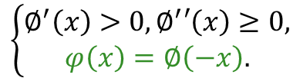
Lipschitz GANs
General formulation:
As long as, it satisfies:
Any increasing function with no decreasing derivative derives a LGAN.
The Lipschitz constant of $f$.
$$𝔼_{z\sim P_{z}}∅\left(f\left(g(z)\right)\right)+𝔼_{x\sim P_{r}}φ\left(f\left(x\right)\right)+λ∙{k(f)}^{2}$$
$$f\left(x\right) ∈ ℝ$$
$$∅\left(x\right):ℝ→ℝ$$
$$φ\left(x\right):ℝ→ℝ$$
The generalized formulation of GANs.
$$\left\{\begin{aligned}∅^{′}\left(x\right)>0,∅^{′}′\left(x\right)≥0, \\ φ^{′}\left(x\right)<0,φ^{′}\left(x\right)≥0, \\ ∃a,∅^{′}\left(a\right)+φ^{′}\left(a\right)=0.\end{aligned}\right.$$
or simplified as:
(more restrictive)
$$\left\{\begin{aligned}∅^{′}\left(x\right)>0,∅^{′}′\left(x\right)≥0, \\ φ\left(x\right)=∅\left(−x\right).\end{aligned}\right.$$

Slide 14
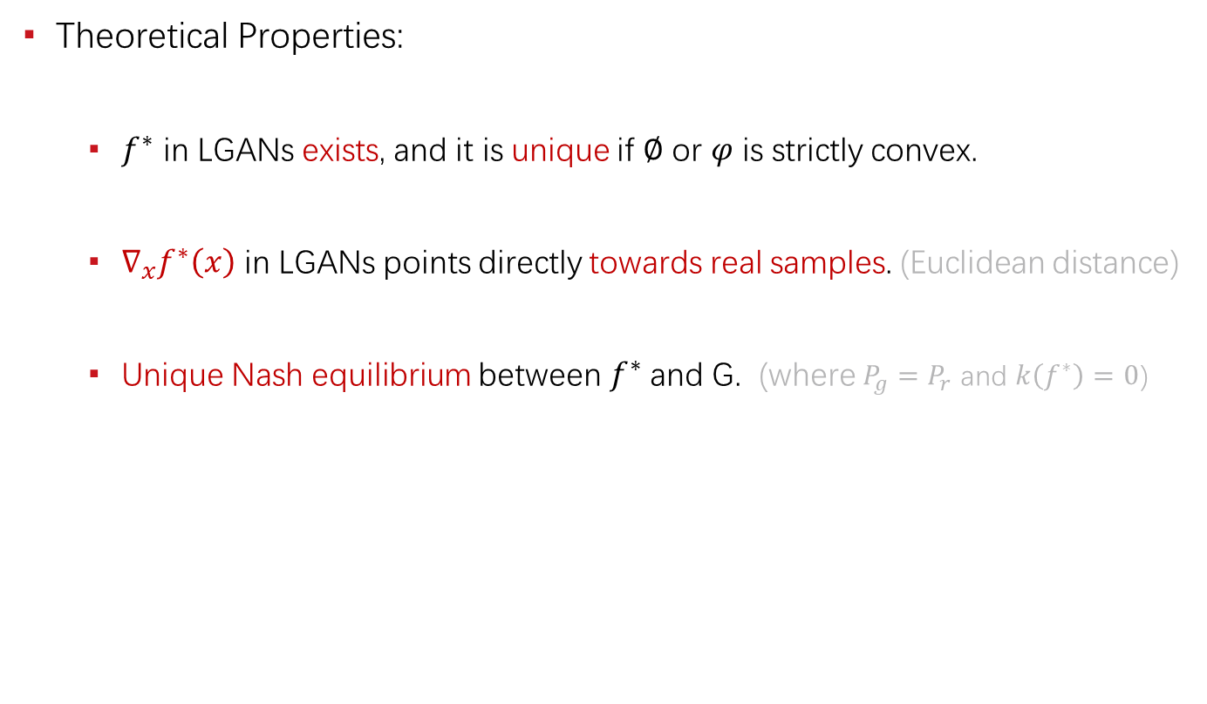
Lipschitz GANs
Theoretical Properties:
$f^{∗}$ in LGANs exists, and it is unique if $∅$ or $φ$ is strictly convex.
$∇_{x}f^{∗}\left(x\right)$ in LGANs points directly towards real samples. (Euclidean distance)
Unique Nash equilibrium between $f^{∗}$ and G. (where $P_{g}=P_{r}$ and $k\left(f^{∗}\right)=0$)

Slide 15
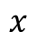
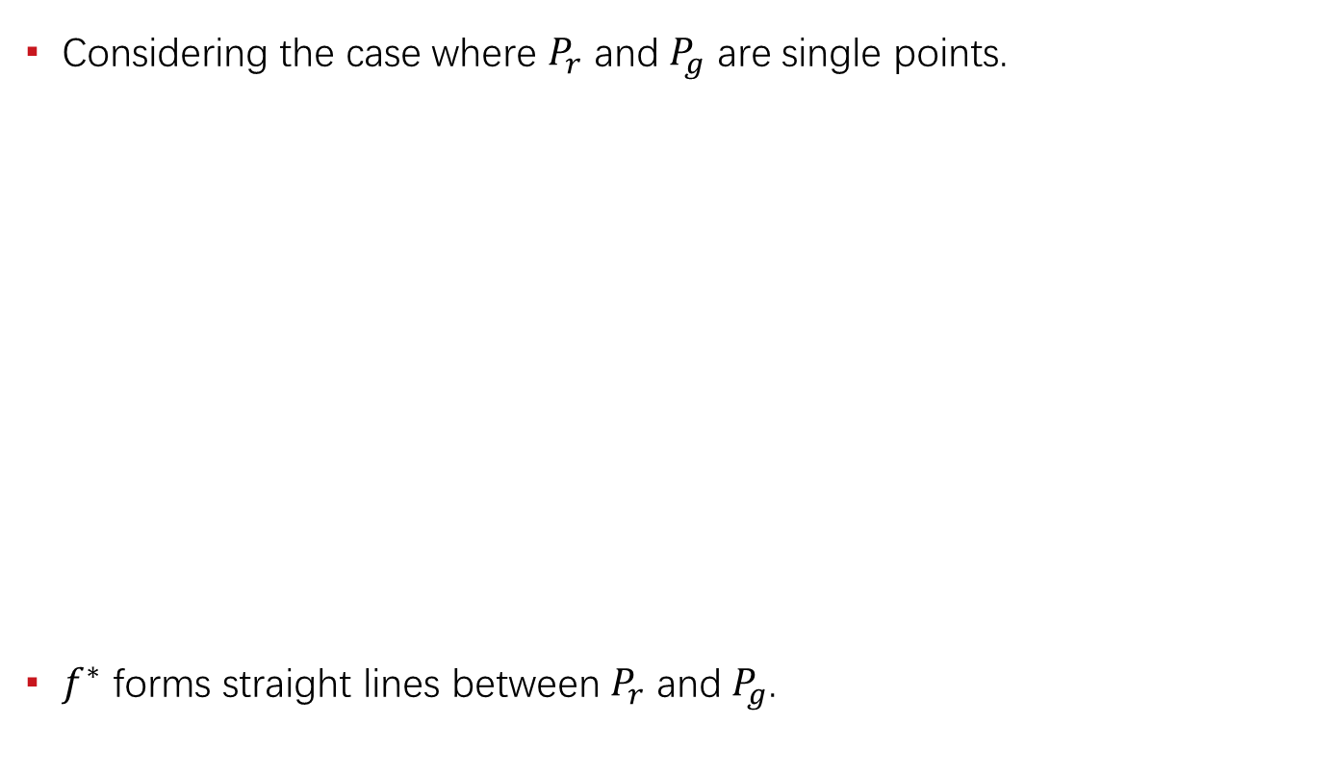
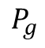
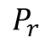
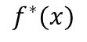
Illustration
Considering the case where $P_{r}$ and $P_{g}$ are single points.
$f^{∗}$ forms straight lines between $P_{r}$ and $P_{g}$.
$$f^{∗}(x)$$
The line in between is well defined, while others are not.
$$P_{r}$$
$$P_{g}$$
$$x$$

Slide 16
Experiments
Practical behaviors of gradient uninformativeness: (noise)

Slide 17
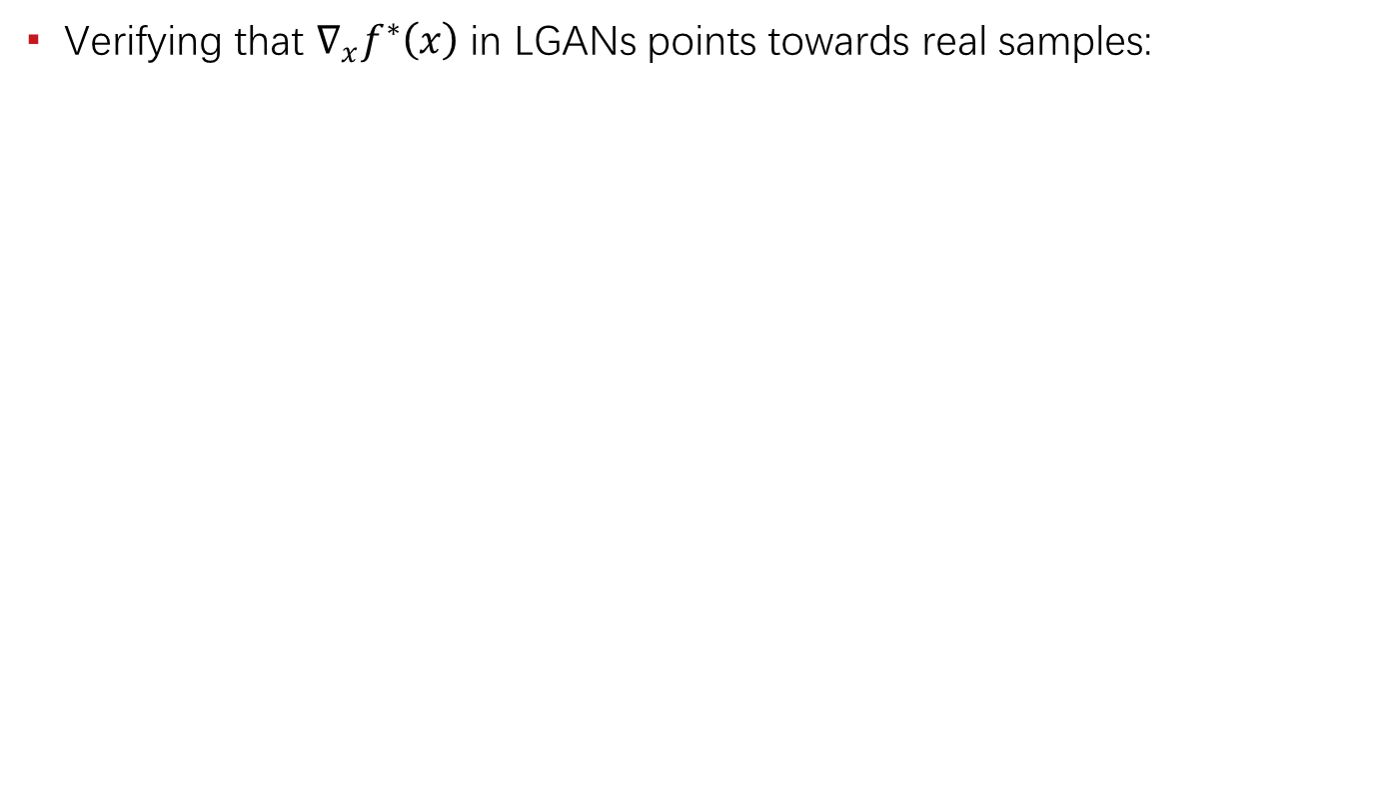
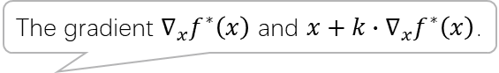
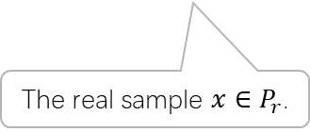
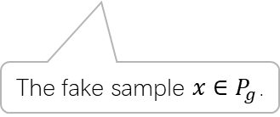
Experiments
Verifying that $∇_{x}f^{∗}\left(x\right)$ in LGANs points towards real samples:
The gradient $∇_{x}f^{∗}\left(x\right)$ and $x+k∙∇_{x}f^{∗}\left(x\right)$.
The fake sample $x∈P_{g}$.
The real sample $x∈P_{r}$.

Slide 18

Experiments
The influence of uniqueness of $f^{∗}$: (stabilized)

Slide 19
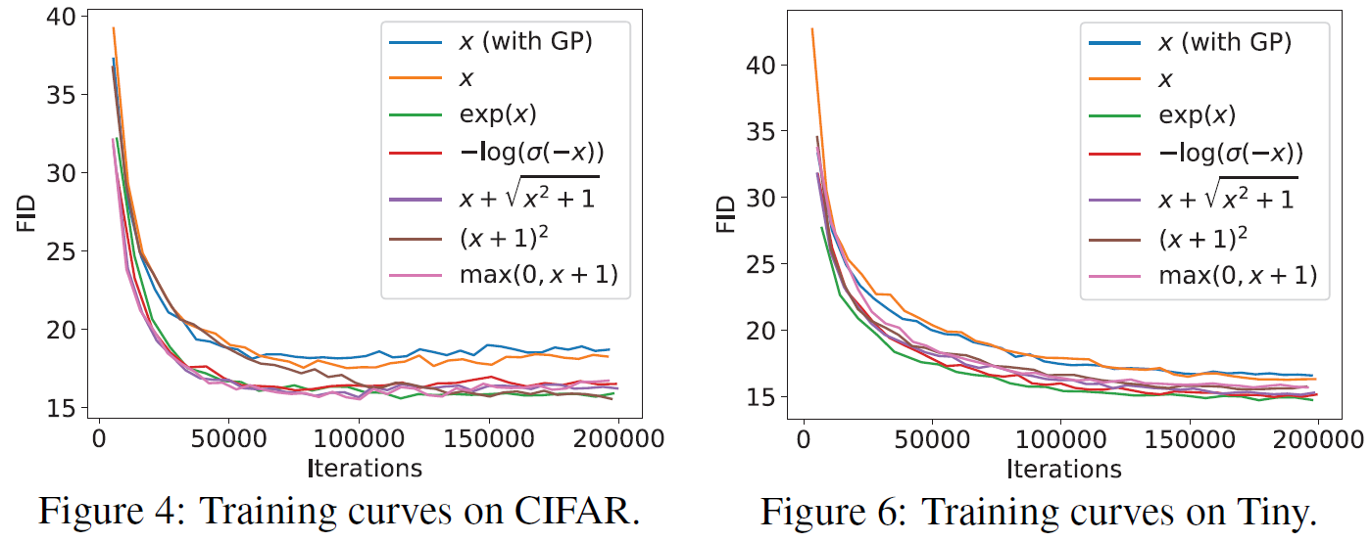
Experiments
Benchmark the LGANs family: (consistently outperform WGAN)

Slide 20
Experiments
Benchmark the LGANs family: (consistently outperform WGAN)

Slide 21

Mode Collapse
Objective level cause: (major)
Unrestricted GANs (including vanilla GAN)
Existence of gathering / clustering effect. (local greedy)
Missing of force to separate clustered samples.
Existence of local optimum.
WGAN / LGANs
No objective level local optimum.
Existence of force to separate clustered samples. (if not clustered to a single point)
Neural network level cause: (minor)
Network degeneration. (related to training failure)
Limited capacity / expressiveness issue.
A local optimum state of some traditional GANs.

Slide 22
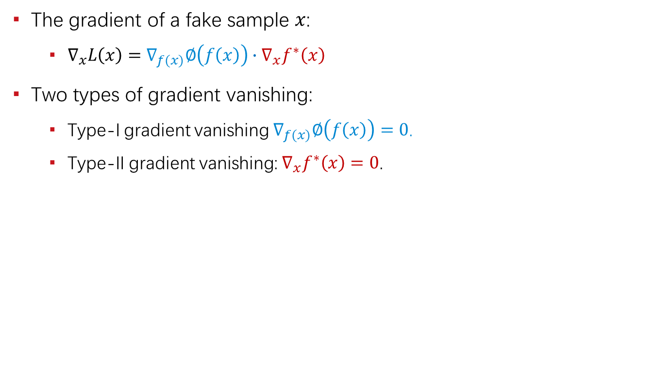
Gradient Vanishing
The gradient of a fake sample $x$:
$∇_{x}L\left(x\right)=∇_{f(x)}∅\left(f\left(x\right)\right)∙∇_{x}f^{∗}\left(x\right)$
Two types of gradient vanishing:
Type-I gradient vanishing $∇_{f(x)}∅\left(f\left(x\right)\right)=0$.
Type-II gradient vanishing: $∇_{x}f^{∗}\left(x\right)=0$.
 | Type-I Gradient Vanishing | Type-II Gradient Vanishing
Vanilla GAN | Yes | Yes
Least-squares GAN | No | Yes
WGAN / LGANs | No | No

Slide 23
Understanding Unregularized GANs
The adversarial activation maximization process
In contrast to the divergence perspective
How unregularized GANs work in practice
Flat/simple network surface
Network structure, optimizer, etc.
Parameter tuning.
Delicate balance between G and D.

Slide 24
Unreachable Optimum
Evidences & Possible Causes

Slide 25
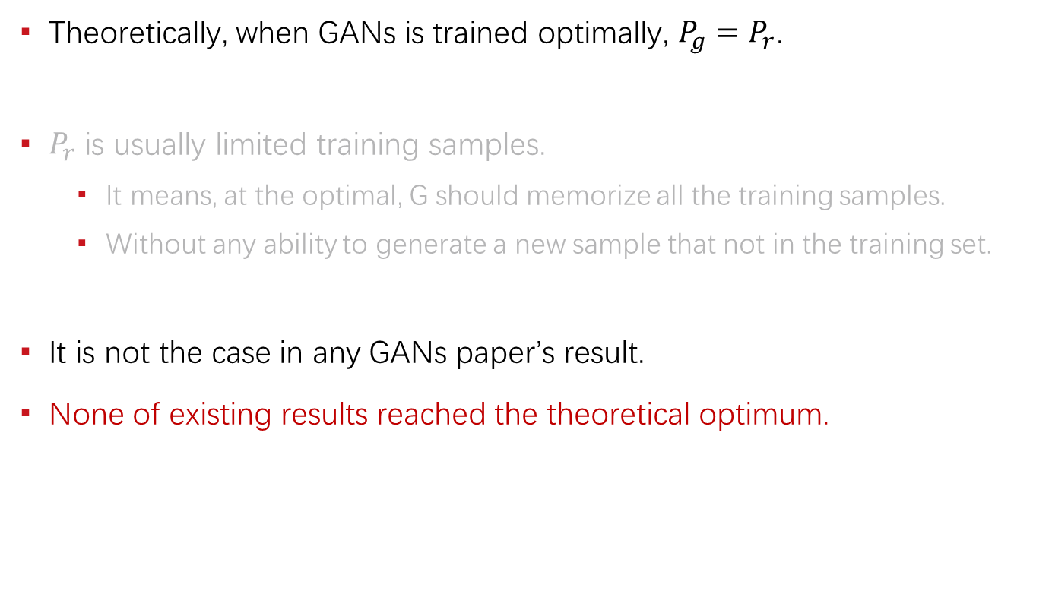
The Evidences
Theoretically, when GANs is trained optimally, $P_{g}=P_{r}$.
$P_{r}$ is usually limited training samples.
It means, at the optimal, G should memorize all the training samples.
Without any ability to generate a new sample that not in the training set.
It is not the case in any GANs paper’s result.
None of existing results reached the theoretical optimum.

Slide 26
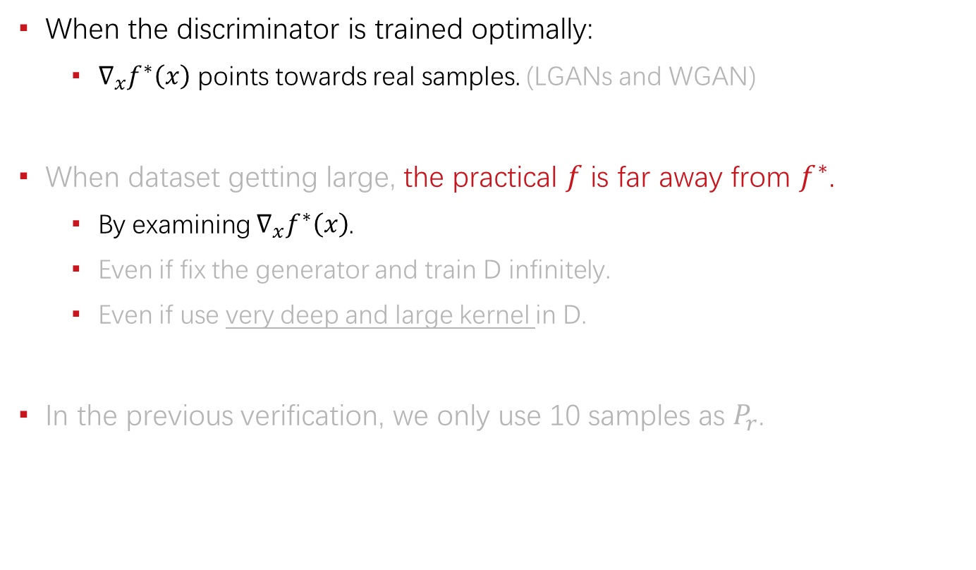
The Evidences
When the discriminator is trained optimally:
$∇_{x}f^{∗}\left(x\right)$ points towards real samples. (LGANs and WGAN)
When dataset getting large, the practical $f$ is far away from $f^{∗}$.
By examining $∇_{x}f^{∗}\left(x\right)$.
Even if fix the generator and train D infinitely.
Even if use very deep and large kernel in D.
In the previous verification, we only use 10 samples as $P_{r}$.

Slide 27
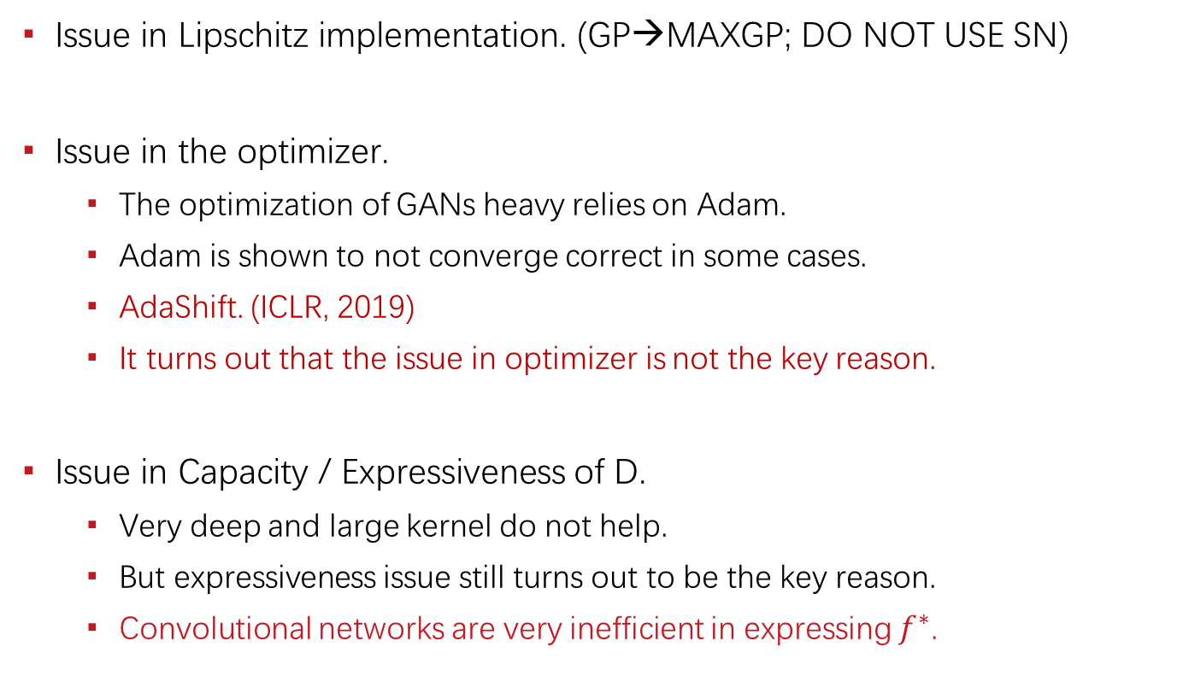
Possible Causes
Issue in Lipschitz implementation. (GP→MAXGP; DO NOT USE SN)
Issue in the optimizer.
The optimization of GANs heavy relies on Adam.
Adam is shown to not converge correct in some cases.
AdaShift. (ICLR, 2019)
It turns out that the issue in optimizer is not the key reason.
Issue in Capacity / Expressiveness of D.
Very deep and large kernel do not help.
But expressiveness issue still turns out to be the key reason.
Convolutional networks are very inefficient in expressing $f^{∗}$.

Slide 28
Generalization Issue
Work in progress.

Slide 29
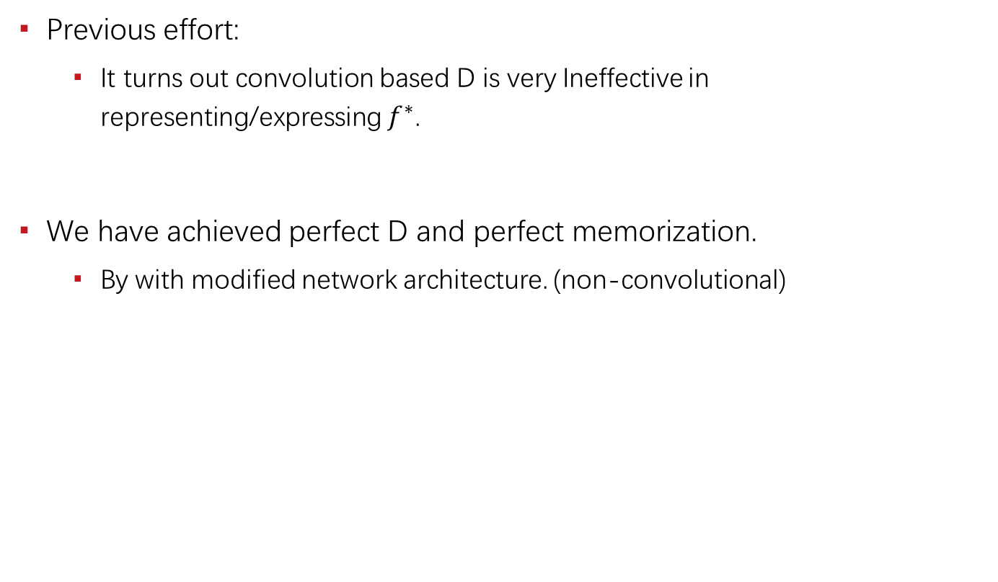
Reach the Optimum
Previous effort:
It turns out convolution based D is very Ineffective in representing/expressing $f^{∗}$.
We have achieved perfect D and perfect memorization.
By with modified network architecture. (non-convolutional)

Slide 30
Dilemma
Whether we should reach the optimum?
Reach the optimum.
But fail to generalize.
Does not reach the optimum.
Practically, some ability to generalize.

Slide 31
The Ideal Solution
Objective level generalization:
Achieve the optimum.
Modify the objective such that it allows generalization at optimum.
The short-term gain may be negative.
But I believe this is the right direction and something need to be done.

Slide 32
Comparison
Generative model
No generalization at optimum.
The mapping function is fully defined, i.e., all points are mapped to the given dataset.
Discriminative model
Generalization at optimum.
The learned function is only defined at finite points identified by the dataset.
In GANs, new samples will be regards as fake, if the D is powerful enough.

Slide 33
Reference
[1] Zhou, Zhiming, Jiadong Liang, Yuxuan Song, Lantao Yu, Hongwei Wang, Weinan Zhang, Yong Yu, and Zhihua Zhang. "Lipschitz Generative Adversarial Nets." In International Conference on Machine Learning (ICML), 2019.
[2] Zhou, Zhiming*, Qingru Zhang*, Guansong Lu, Hongwei Wang, Weinan Zhang, and Yong Yu. "AdaShift: Decorrelation and Convergence of Adaptive Learning Rate Methods." In International Conference on Learning Representations (ICLR), 2019.
[3] Zhou, Zhiming, Han Cai, Shu Rong, Yuxuan Song, Kan Ren, Weinan Zhang, Jun Wang, and Yong Yu. "Activation Maximization Generative Adversarial Nets." In International Conference on Learning Representations (ICLR), 2018.
https://scholar.google.com/citations?user=b8YJ1EMAAAAJ&hl=en

Slide 34
谢 谢！

